Slide 1
Trajectory Generation
Reza Ghabcheloo
IHA 4306 Moro

Slide 2
Problem
Given two (or more) robot configurations, generate a feasible trajectory connecting those configurations
Satisfying certain constraints

Slide 3
Constraints
Kinematics: joint/workspace speed, acceleration, jerk limits
Dynamics: joint torques/force limits
Geometric: joint/workspace limits, obstacles
Temporal: reaching a given configuration in a given time

Slide 4
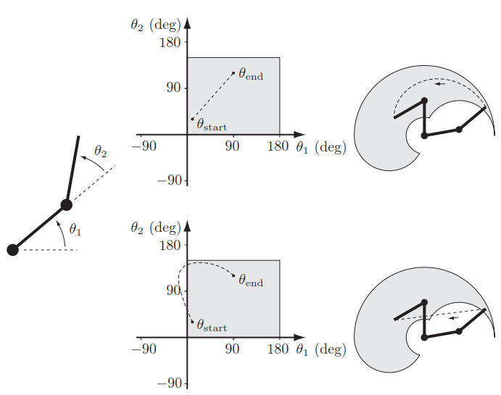
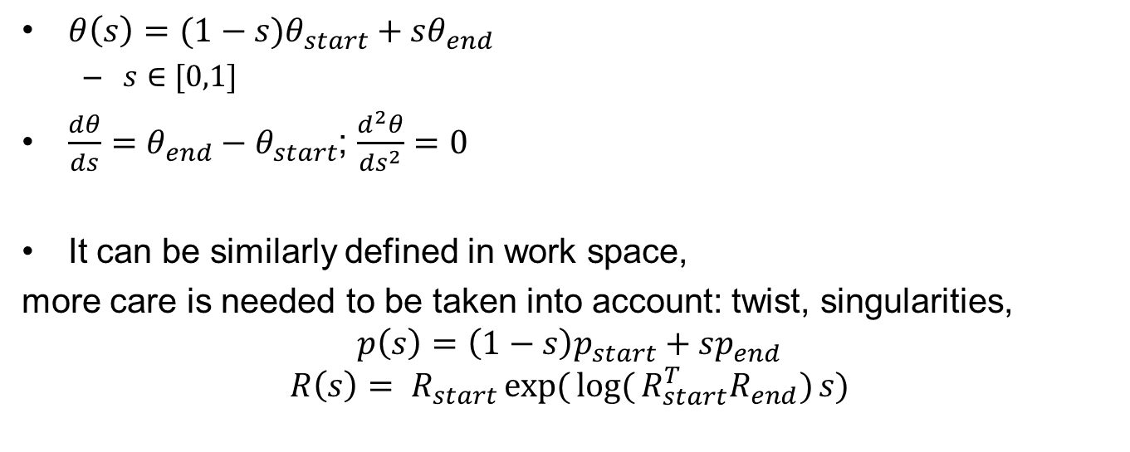
Straight line
$θ\left(s\right)=(1−s)θ_{start}+sθ_{end}$
$s∈[0,1]$
$\frac{dθ}{ds}=θ_{end}−θ_{start}$; $\frac{d^{2}θ}{ds^{2}}=0$
It can be similarly defined in work space,
more care is needed to be taken into account: twist, singularities,
$$p\left(s\right)=\left(1−s\right)p_{start}+sp_{end}$$
$$R\left(s\right)= R_{start}exp({\log{(}R_{start}^{T}R_{end})}s)$$

Slide 5
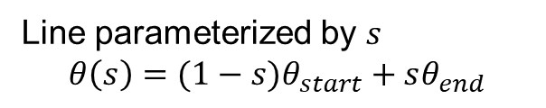
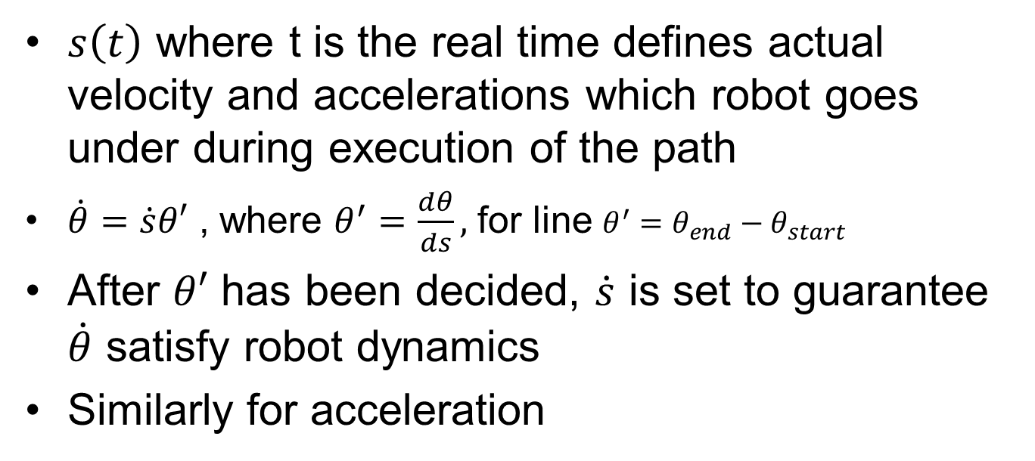
Time scaling
Line parameterized by $s$
$$θ\left(s\right)=(1−s)θ_{start}+sθ_{end}$$
$s\left(t\right)$ where t is the real time defines actual velocity and accelerations which robot goes under during execution of the path
$\dot{θ}=\dot{s}θ′$ , where $θ^{′}=\frac{dθ}{ds},$ for line ${θ^{′}=θ}_{end}−θ_{start}$
After $θ′$ has been decided, $\dot{s}$ is set to guarantee $\dot{θ}$ satisfy robot dynamics
Similarly for acceleration

Slide 6
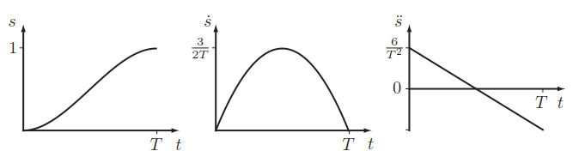
How s(t) is designed
Polynomial s(t) functions (ex. s constant, cubic, trapezoidal, etc), closed-form functions can be found between polynomial parameters and robot vel and acc limits
Further reading:
Reference 1, Sec. 9.2
ASE-9407 Robot Manipulators

Slide 7
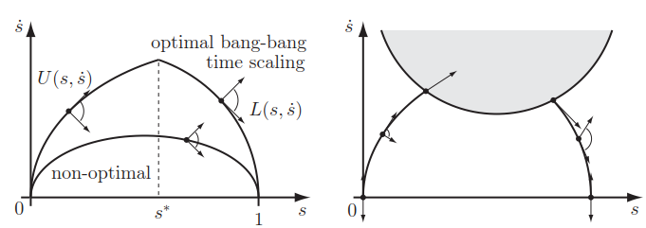
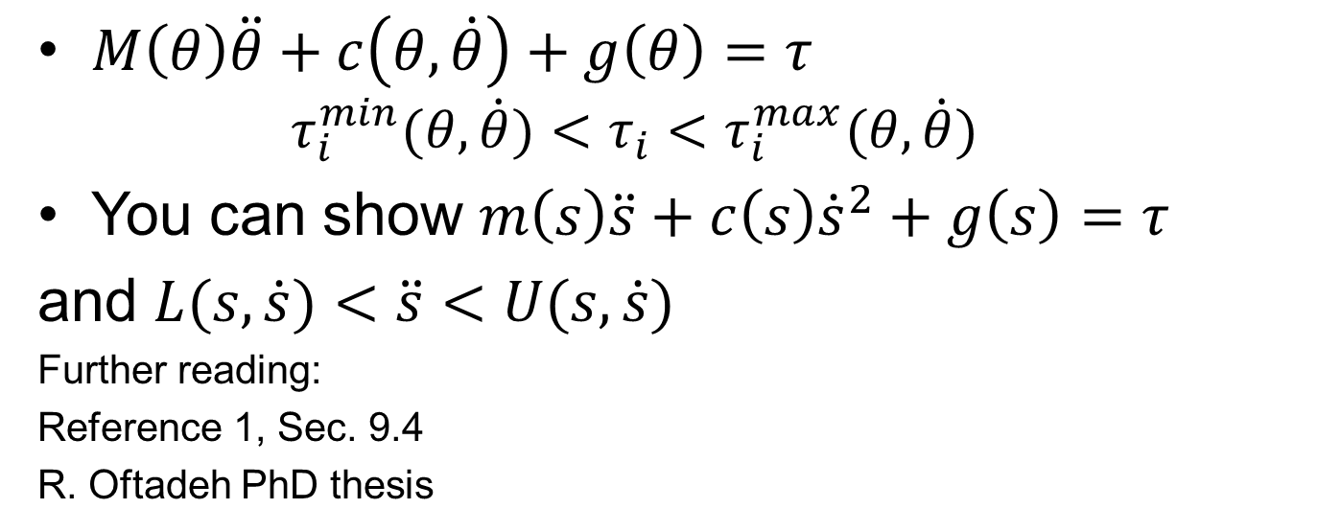
Satisfying robot torques limits, time optimal
Bonus page
$M\left(θ\right)\ddot{θ}+c\left(θ, \dot{θ}\right)+g\left(θ\right)=τ$
$$τ_{i}^{min}(θ,\dot{θ})<τ_{i}<τ_{i}^{max}(θ,\dot{θ})$$
You can show $m\left(s\right)\ddot{s}+c\left(s\right){\dot{s}}^{2}+g\left(s\right)=τ$
and $L(s,\dot{s})<\ddot{s}<U(s,\dot{s})$
Further reading:
Reference 1, Sec. 9.4
R. Oftadeh PhD thesis

Slide 8
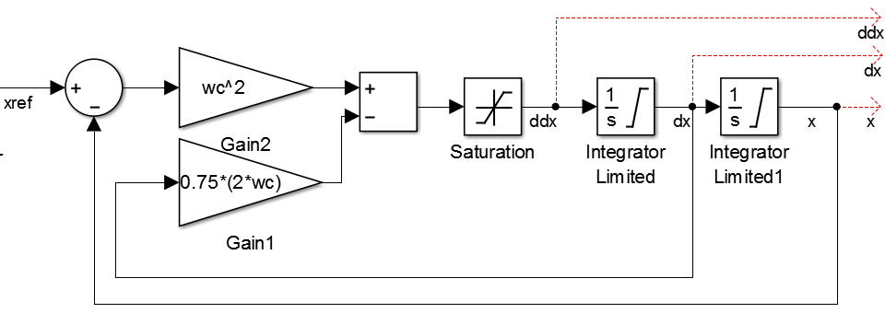

Reference generation on the fly or feedback planner: what if the start and end configurations are not known a priory, such as in tele-operation, or the robot is exposed to jumpy sensor data (e.g. due to human presence)
Given reference signal $x_{ref}$, you can generate $x, \dot{x}, \ddot{x}$ that satisfy position, speed, and acceleration limits as well as bandwidth $ω_{c}$
Q: what is the transfer function $\frac{x}{x_{ref}}$, neglect saturations?
acc lim
vel lim
pos lim

Slide 9
Smooth path and way points
Q: what would the output of feedback planner
to this way-point signal?

Slide 10
Problem definition
Given set of ways points, generate a smooth trajectory that passes close to the way points, and satisfies constraints such as
Exact start and end configuration
Continuous jerk
Bounded vel, acc, and jerk
etc

Slide 11
Formulating the problem
It turns out that we can formulate the problem as a quadratic program
Core idea:
Represent the entire trajectory with segments
Each segment is represented by polynomials, Bezier curves and B-Splines,
Make sure segments are smooth at joints

Slide 12
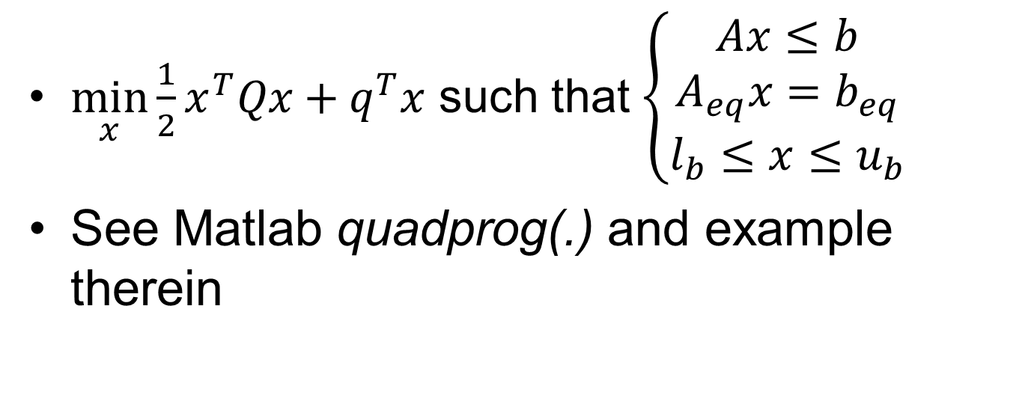
Quadratic program
$\min_{x}{\frac{1}{2}x^{T}Qx+q^{T}x}$ such that $\left\{\begin{matrix}Ax≤b \\ A_{eq}x=b_{eq} \\ l_{b}≤x≤u_{b}\end{matrix}\right.$
See Matlab quadprog(.) and example therein

Slide 13
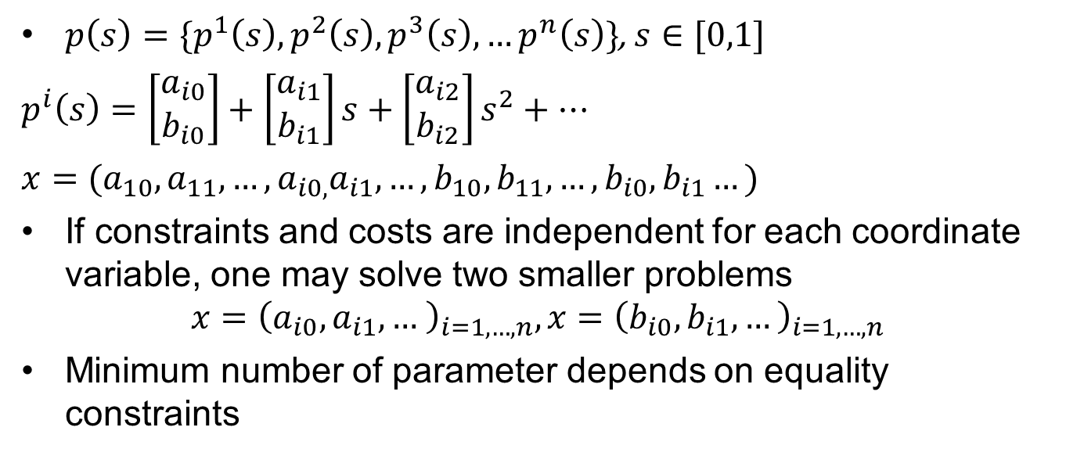
Trajectory segments and Polynomial example for each segment
$p\left(s\right)=\{p^{1}\left(s\right),p^{2}\left(s\right),p^{3}\left(s\right),…p^{n}\left(s\right)\}$, $s∈[0,1]$
$p^{i}\left(s\right)=\left[\begin{matrix}a_{i0} \\ b_{i0}\end{matrix}\right]+\left[\begin{matrix}a_{i1} \\ b_{i1}\end{matrix}\right]s+\left[\begin{matrix}a_{i2} \\ b_{i2}\end{matrix}\right]s^{2}+…$
$x=(a_{10},a_{11},…,a_{i0,}a_{i1},…,b_{10},b_{11},…,b_{i0},b_{i1}…)$
If constraints and costs are independent for each coordinate variable, one may solve two smaller problems
$$x={\left(a_{i0},a_{i1},… \right)}_{i=1,…,n},x={\left(b_{i0},b_{i1},…\right)}_{i=1,…,n}$$
Minimum number of parameter depends on equality constraints

Slide 14
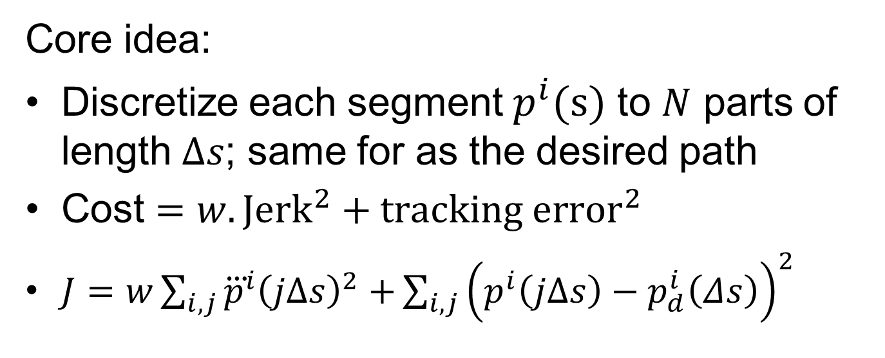
Formulation and the Cost
Core idea:
Discretize each segment $p^{i}(s)$ to $N$ parts of length $Δs$; same for as the desired path
Cost $=w.Jerk^{2}+tracking {error}^{2}$
$J=w\sum_{i,j}{{\overset{⃛}{p}}^{i}{\left(jΔs\right)}^{2}+}\sum_{i,j}{{\left(p^{i}\left(jΔs\right)−p_{d}^{i}\left(Δs\right)\right)}^{2}}$

Slide 15
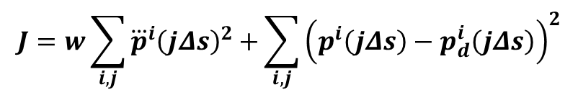
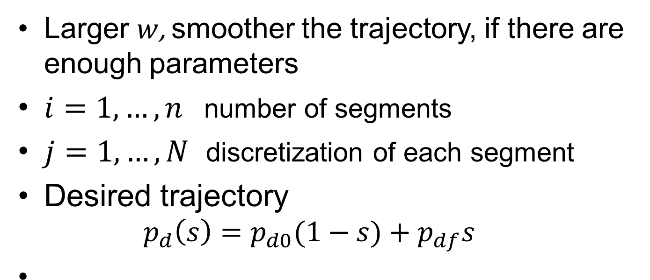
Cost
$$J=w\sum_{i,j}{{\overset{⃛}{p}}^{i}{\left(jΔs\right)}^{2}+}\sum_{i,j}{{\left(p^{i}\left(jΔs\right)−p_{d}^{i}\left(jΔs\right)\right)}^{2}}$$
Larger $w$, smoother the trajectory, if there are enough parameters
$i=1,…,n$ number of segments
$j=1,…,N$ discretization of each segment
Desired trajectory
$$p_{d}\left(s\right)=p_{d0}(1−s)+p_{df}s$$

Slide 16
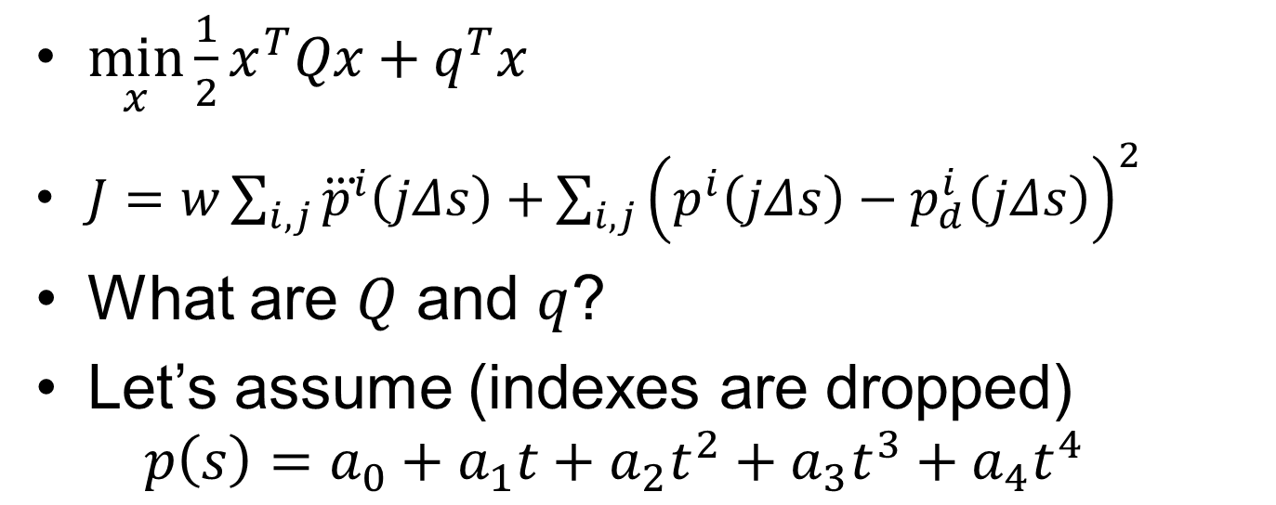
Cost suitable for quadprog
$\min_{x}{\frac{1}{2}x^{T}Qx+q^{T}x}$
$J=w\sum_{i,j}{{\overset{⃛}{p}}^{i}\left(jΔs\right)+}\sum_{i,j}{{\left(p^{i}\left(jΔs\right)−p_{d}^{i}\left(jΔs\right)\right)}^{2}}$
What are $Q$ and $q$?
Let’s assume (indexes are dropped)
$$p\left(s\right)=a_{0}+a_{1}t+a_{2}t^{2}+a_{3}t^{3}+a_{4}t^{4}$$

Slide 17
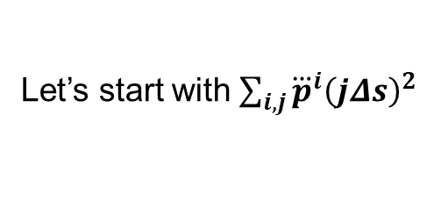
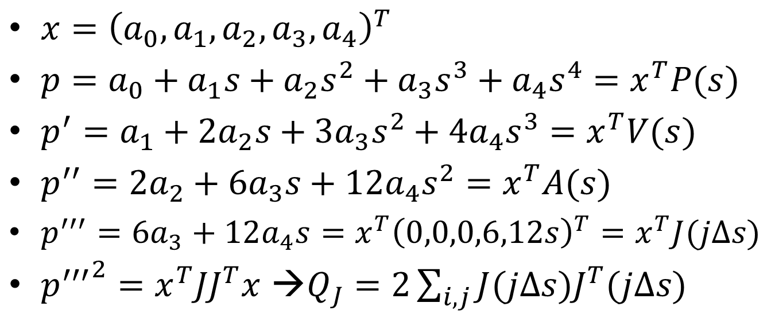
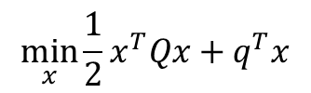
Some maths
Let’s start with $\sum_{i,j}{{\overset{⃛}{p}}^{i}{\left(jΔs\right)}^{2}}$
$$\min_{x}{\frac{1}{2}x^{T}Qx+q^{T}x}$$
$x={\left(a_{0},a_{1},a_{2},a_{3},a_{4}\right)}^{T}$
$p=a_{0}+a_{1}s+a_{2}s^{2}+a_{3}s^{3}+a_{4}s^{4}=x^{T}P(s)$
$p^{′}=a_{1}+2a_{2}s+3a_{3}s^{2}+4a_{4}s^{3}=x^{T}V(s)$
$p^{′′}=2a_{2}+6a_{3}s+12a_{4}s^{2}=x^{T}A(s)$
$p^{′′′}=6a_{3}+12a_{4}s=x^{T}{\left(0,0,0,6,12s\right)}^{T}=x^{T}J(jΔs)$
${p^{′′′}}^{2}=x^{T}JJ^{T}x$ →$Q_{J}=2\sum_{i,j}{J(jΔs)J^{T}(jΔs)}$

Slide 18
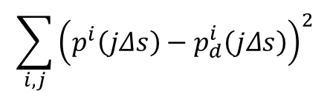
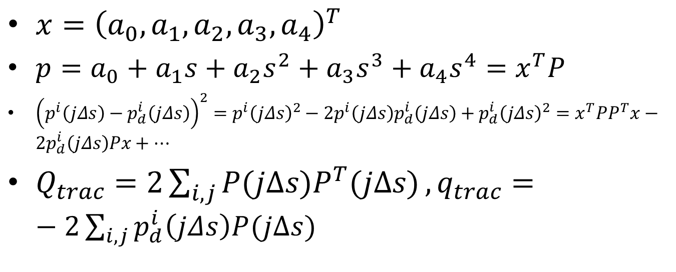
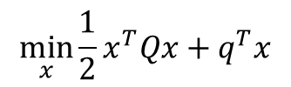
Some maths
$$\sum_{i,j}{{\left(p^{i}\left(jΔs\right)−p_{d}^{i}\left(jΔs\right)\right)}^{2}}$$
$$\min_{x}{\frac{1}{2}x^{T}Qx+q^{T}x}$$
$x={\left(a_{0},a_{1},a_{2},a_{3},a_{4}\right)}^{T}$
$p=a_{0}+a_{1}s+a_{2}s^{2}+a_{3}s^{3}+a_{4}s^{4}=x^{T}P$
${\left(p^{i}\left(jΔs\right)−p_{d}^{i}\left(jΔs\right)\right)}^{2}=p^{i}{\left(jΔs\right)}^{2}−2p^{i}\left(jΔs\right)p_{d}^{i}\left(jΔs\right)+p_{d}^{i}{\left(jΔs\right)}^{2}=x^{T}PP^{T}x−2p_{d}^{i}\left(jΔs\right)Px+…$
$Q_{trac}=2\sum_{i,j}{P(jΔs)P^{T}(jΔs)}, q_{trac}=−2\sum_{i,j}{p_{d}^{i}\left(jΔs\right)P(jΔs)}$

Slide 19

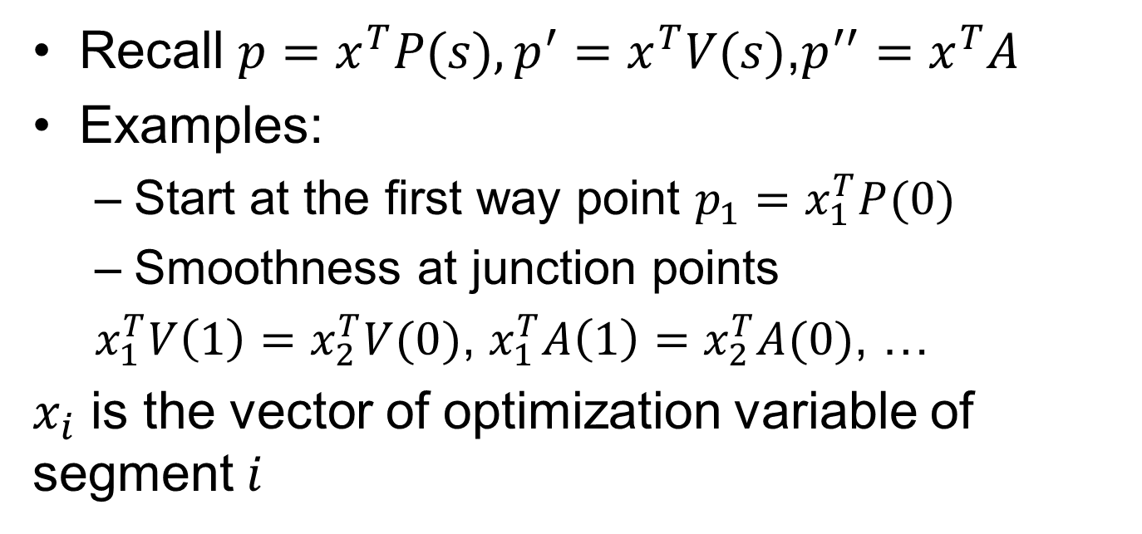
Some maths constraints
$$A_{eq}x=b_{eq}$$
Recall $p=x^{T}P(s), p^{′}=x^{T}V(s)$,$p^{′′}=x^{T}A$
Examples:
Start at the first way point $p_{1}=x_{1}^{T}P(0)$
Smoothness at junction points
$x_{1}^{T}V\left(1\right)=x_{2}^{T}V(0)$, $x_{1}^{T}A\left(1\right)=x_{2}^{T}A(0)$, …
$x_{i}$ is the vector of optimization variable of segment $i$

Slide 20
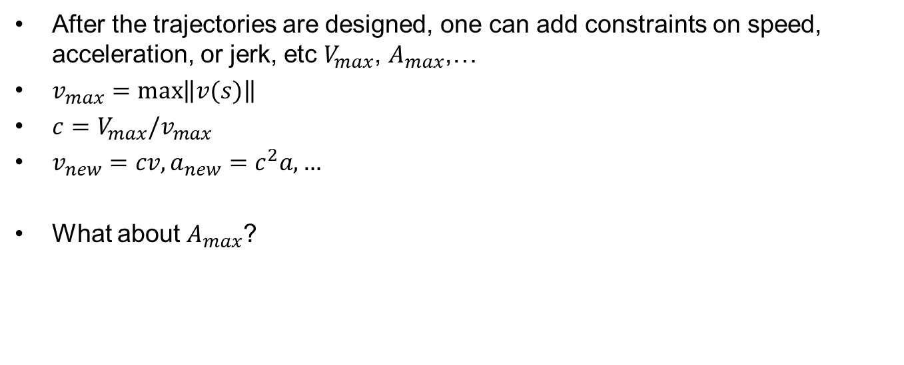
Time scaling revisited
After the trajectories are designed, one can add constraints on speed, acceleration, or jerk, etc $V_{max}$, $A_{max}$,…
$v_{max}=\max\left\|v(s)\right\|$
${c=V_{max}/v}_{max}$
$v_{new}=cv,a_{new}=c^{2}a,…$
What about $A_{max}$?

Slide 21
Main references
MODERN ROBOTICS: MECHANICS, PLANNING, AND CONTROL by Kevin M. Lynch and Frank C. Park, 2017 (Sec 10.6)

